Slide 1





Having a hard time reading something?
Remember, you can zoom in on any part of this document. Just use the zoom button. The little dropdown arrow next to it has an option called “zoom in.”
Graphic Organizer with
Sentence Starters
The title of the best thing I read this term is . . .
Write the title of the best thing you read this term.
This term, the assignment I enjoyed the most was . . .
Complete the sentence.
One thing I would like to learn about is . . .
Complete the sentence.
A quote (by . . . ) that inspires me is . . .
Complete the sentence.
One app I liked was . . .
Or you can click the zoom button and then click and drag the area you want to zoom in. That way, it’s zoomed to exactly the part you need! And you can always zoom out by choosing “fit” in the zoom dropdown menu.
Select the app you liked most.
My grade [accurately/inaccurately] reflects my work and work ethic because . . .
One strength I could use to [improve my grade / keep the grade I have] is . . .
Complete the sentences.
One thing I am proud of doing this term is . . .
Complete the sentence.
One thing I could work on doing better next term is . . .
Complete the sentence.

Slide 2
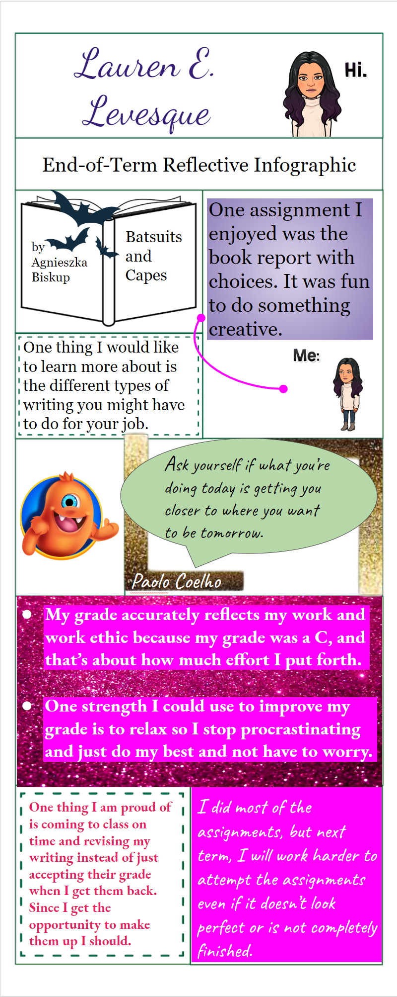
Having a hard time reading something?
Remember, you can zoom in on any part of this document. Just use the zoom button. The little dropdown arrow next to it has an option called “zoom in.”
Example
Or you can click the zoom button and then click and drag the area you want to zoom in. That way, it’s zoomed to exactly the part you need! And you can always zoom out by choosing “fit” in the zoom dropdown menu.

